Slide 1


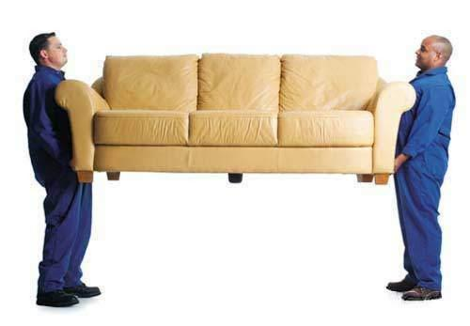

Mobile | Jobs | Contact | Media | Site Map | Legal
Umove!
View Map
Sign Up
About
Beacon Hill
Somerville
Cambridge
Back Bay
Wellesley
Brookline
Read the Feedback
On our Top Rated Movers
Buy Boxes

Slide 2
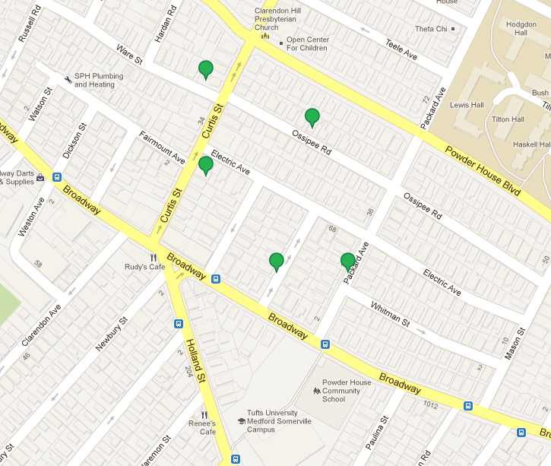
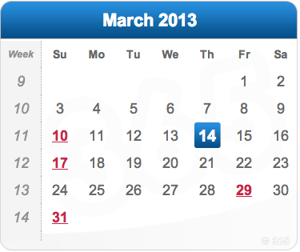
Name | Address | Pay | Approx. hrs | Note
Benny Smith | 45 Packard Ave | 15/hr | 3 | 8am -11am.
Joe Blow | 61 Ossipee St. | 15/hr | 5 | Any time. Two people needed.
James Chrispt | 100 Curtis St. | 30/hr | 2 | Heavy desk. No vehicle needed
Nina Wang | 30 Ware St. | 20/hr | N/A | Moving things to storage. Need a vehicle
Lizzy Phillips | 10 Lovell St | 30/hr | 5 | Cleaning house. Pickup truck preferred.

Slide 3
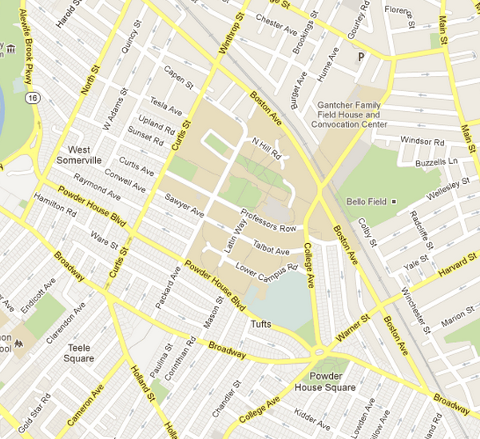
Name | Type of Vehicle | Feedback | Time Available
Scott Brown | Pickup Truck |  | All day

Slide 4
Name | Type of Vehicle | Feedback | Time Available
Scott Brown | Pickup Truck |  | All day

Slide 5
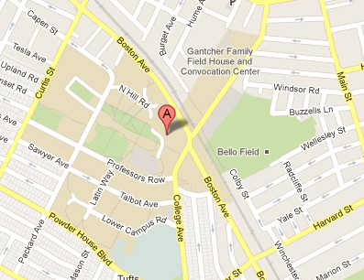
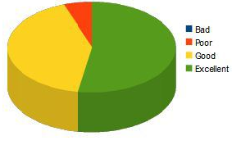
Mover Post #0058
User:
MovingCrew123
Date Posted:
March 14, 2013 at 2:26pm
Availability:
Days – M, T, Th
Times – 12:00pm to 4:00pm
Willing to Travel – 15 miles
Vehicle:
Description – white Ford Explorer with removable back seats and roof racks. Also have bicycle rack if necessary.
Picture – no image available.
Mover Comments:
I am an experienced mover and have been doing this during moving season for several years now. Please don’t hesitate to call if you have and questions or concerns. My phone number is 999-999-9999.

